Slide 1



Mock Sales Data Report
View in Power BI
Last data refresh:
09/07/2024 21:28:44 UTC
Downloaded at:
09/07/2024 22:14:18 UTC

Slide 2
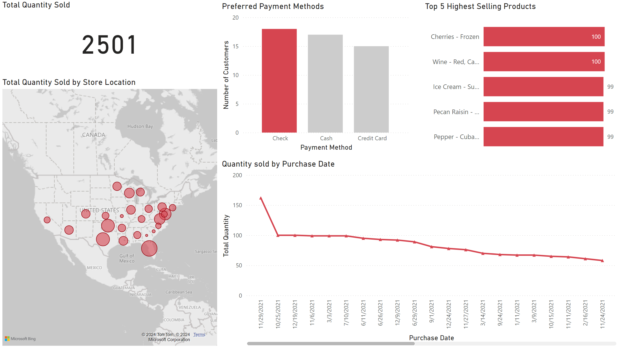
Sales Dashboard
Notes:
Total Quantity Sold
No alt text provided
Total Quantity Sold by Store Location
No alt text provided
Top 5 Highest Selling Products
No alt text provided
Quantity sold by Purchase Date
No alt text provided
Preferred Payment Methods
No alt text provided

